Slide 1
Ch.5 Metrology for Fourier Transform Spectrometers
Lee Jong Geon

Slide 2
Contents
Spectrometer Configurations
Fourier Transform Spectrometer Metrology
Sample Measurement Parameter Recovery
Sources of Noise and Uncertainties

Slide 3
Spectrometer Configurations

Slide 4
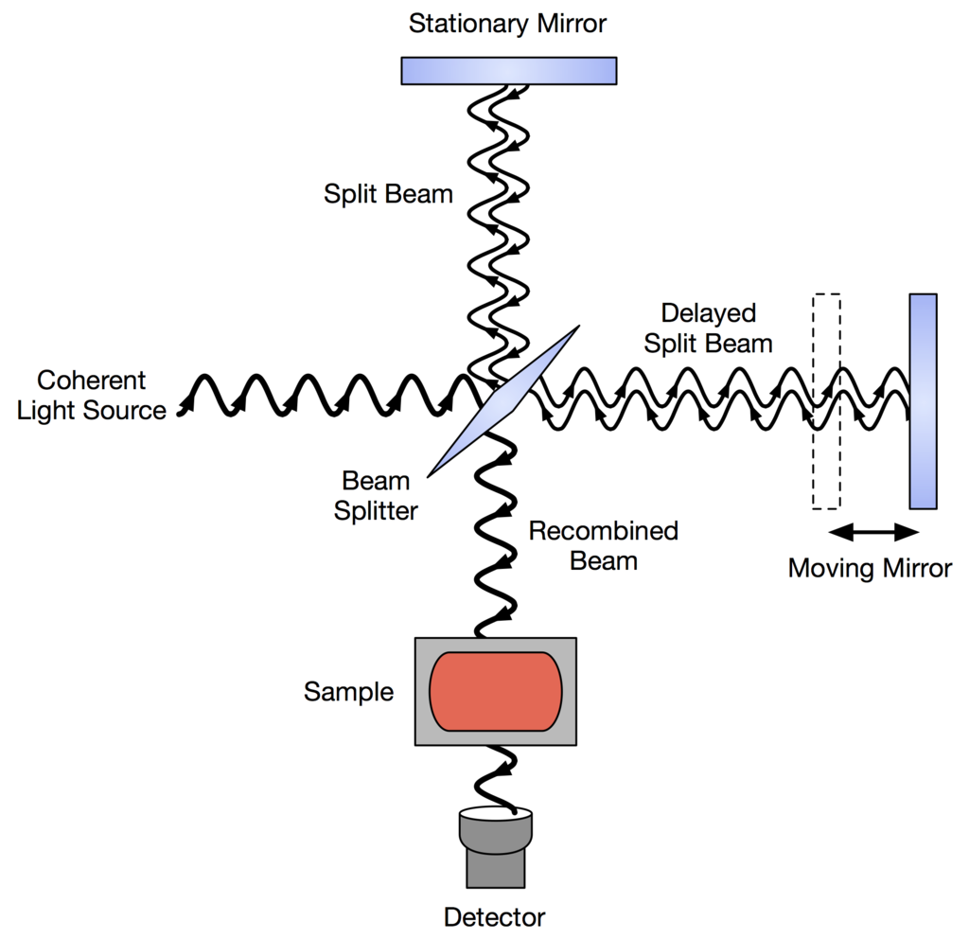
1.1 Michelson
This two-port configuration will inherently perform Fourier spectroscopy of the difference of the two ports.

Slide 5
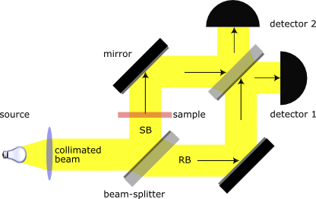
1.2 Mach-Zender
The highly configurable design figure of interferometer unfolds the light path.

Slide 6
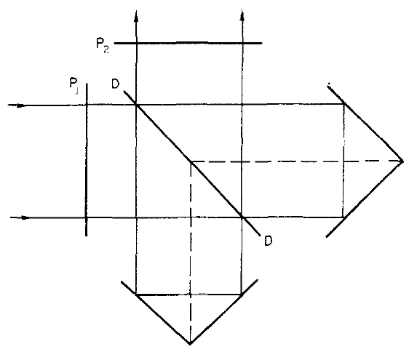
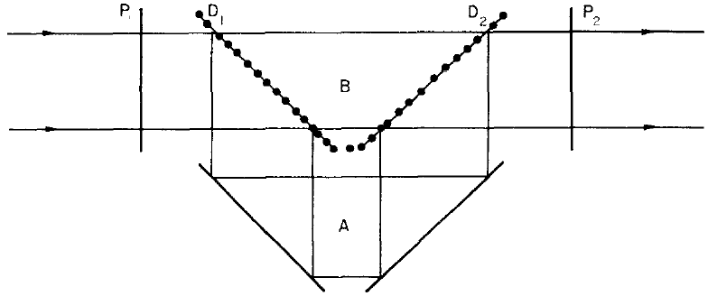
1.3 Polarized Fourier Transform Spectrometer (Martin-Pupplett Interferometer)
Use three polarizers
➔ When the two half signals are recombined, a generic elliptical polarization state is obtained.
Martin, D. H., and E. Puplett, “Polarised Interferometric Spectrometry for the Millimetre and Submillimetre Spectrum,” App. Opt., Vol. 10, 1969.

Slide 7


1.4 Modes of Operation : Step and Integrate or Fast Scanning
All of the Fourier transform spectrometer configurations can be adopted in two substantially differnet modes of operation.
Step and Integrate (SaI): the optical path difference in the interferometer is incremented in discrete steps and the detector signal is integrated when the interferometer mirrors are stationary.
Fast Scanning (FS): the moving mirror of the interferometer is scanned at constant velocity, and some form of metrology is used to sample the interferogram, usually on a uniform optical path difference.
$$∆z≤\frac{1}{2σ_{n}}$$
$$∆z≤\frac{1}{2∙\left(σ_{max}−σ_{min}\right)}$$
Naylor, D. A., et al., “Astronomical Spectroscopy Using an Aliased Step-and-Integrate Fourier Transform Spectrometer,” Proceedings of the SPIE, Vol. 5498, 2004.

Slide 8
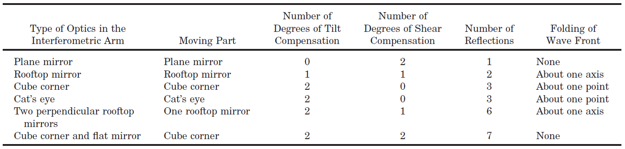
1.5 Moving Stage
In a Martin-Puplett configuration, a variety of mirror configurations can be chosen, each with different advantages and disadvantages.
Carli, B., et al., “Design of an Efficient Broadband Far-Infrared Fourier Transform Spectrometer,” App. Opt., Vol. 38, No. 18, 1999.

Slide 9
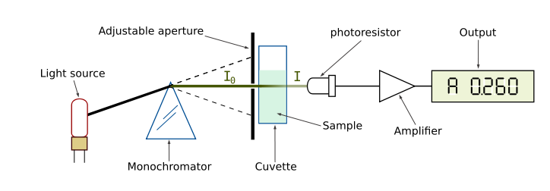
1.6 General Fourier Transform Spectrometer Advantages
There are two known advantages of using a Fourier transform spectrometer when compared to a monochromator or dispersive spectrometers.
The throughput depends only on the size of the collimated beam entering the spectrometer. (Jacquinot advantage)
The multiplexing occuring due to the simultaneous integration of all the wavelengths received by the detector which in turn improves the signal-to-noise ratio. (Felgett advantage)

Slide 10
Fourier Transform
Spectrometer Metrology

Slide 11
2.1 Encoders, Synchronizing, and Time-Stamping
Stage motors are often controlled in either open or closed loop.
Open Loop: assumption that the speed imparted to the stage is exact.
The speed of a stage will not be uniform
Closed Loop: an optical encoder with feedback to the controller allows correction to be made for nonlinear motions in the stage drive.

Slide 12
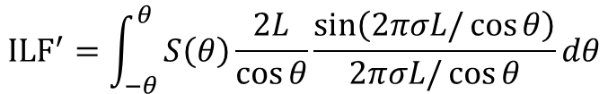




2.2 Instrument Line Function: A Spectral Resolution Limitation
The resolution of the spectrometer is related to the maximum optical path difference that can be imposed on the input beam.
$$L^{′}=\frac{L}{\cos{θ}}$$
Off-axis beam
$$θ$$
$$L$$
$$∆D=\left|L^{′}−L\right|=L\left|\frac{1}{\cos{θ}}−1\right|=L\left|\frac{1−\cos{θ}}{\cos{θ}}\right|≅L\frac{θ^{2}}{2−θ^{2}}≅L\frac{θ^{2}}{2}$$
$$ILF=2L\frac{\sin\left(2πσL\right)}{2πσL}$$
$${ILF}^{′}=\int_{−θ}^{θ}{S\left(θ\right)\frac{2L}{\cos{θ}}\frac{\sin\left(2πσL/\cos{θ}\right)}{2πσL/\cos{θ}}dθ}$$
ILF: Instrument Line Function

Slide 13
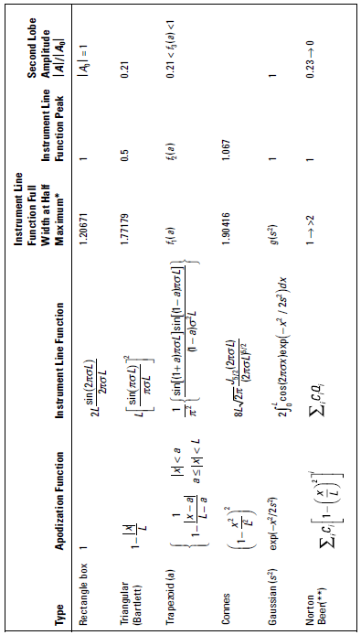
2.3 Apodization
The presence of negative side-lobes and distinct ringing features caused by the sinc ILF can be acceptable for some applications, but not for others.

Slide 14
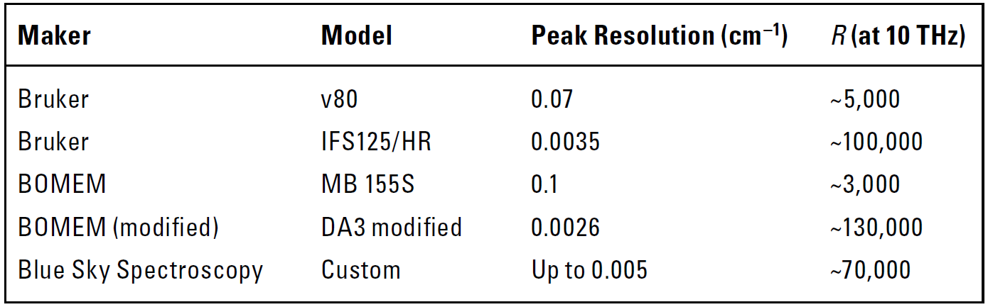
2.4 Achievable Spectral Resolution (Commercial and State of the Art)
Commercial Fourier Transform Spectrometer Instruments and Their Resolutions

Slide 15
Sample Measurement
Parameter Recovery

Slide 16




3.1 Thin Sample Approximation: Lossless Case
A model of the Fabry-Perot etalon presented by the sample can then be fitted.
t
n
$$R\left(σ\right)=\frac{2r^{2}\left(1−\cos{2βt}\right)}{1+r^{4}+2r^{2}\cos{2βt}}$$
$$;r=\frac{1−n}{1+n}, β=2πnσ$$
$$T\left(σ\right)=\frac{1}{1+ℱ\sin^{2}{βd}}$$
$$;ℱ=\frac{4r^{2}}{{\left(1−r^{2}\right)}^{2}}$$

Slide 17
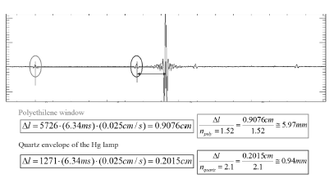
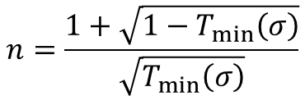
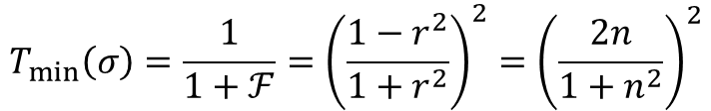
3.1 Thin Sample Approximation: Lossless Case
An Alternative Non-Fourier Method
Minima n-Recovery
$$T_{min}\left(σ\right)=\frac{1}{1+ℱ}={\left(\frac{1−r^{2}}{1+r^{2}}\right)}^{2}={\left(\frac{2n}{1+n^{2}}\right)}^{2}$$
$$n=\frac{1+\sqrt{1−T_{min}\left(σ\right)}}{\sqrt{T_{min}\left(σ\right)}}$$

Slide 18

3.2 Dispersive Medium
Most materials have an index that is a slowly varying function of wavenumber.
➔ Limit the precision of either the recovery of the index value, or of the calibration through a reference sample of the system.
$$n=n\left(σ\right)$$

Slide 19
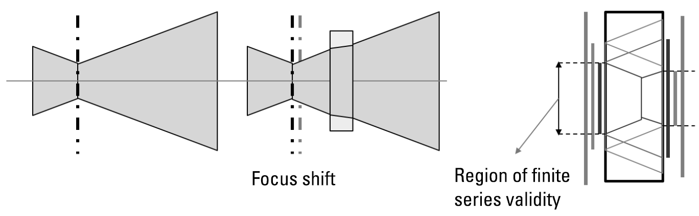


3.3 Thick Sample Analysis (or Noncollimated Measurement)
In a converging beam, the thick sample results will vary from the previous in at least two characteristics.
Weighted Contributions at an Angle
$$T\left(σ\right)=\sum_{θ}{w\left(θ\right)T_{θ}\left(σ\right)}$$
$$;T_{θ}\left(σ\right)=T\left(σ;d→d/\cos{θ}\right)$$
Finite Series of Terms
Due to the noncollimated nature of the beam, only a limited number of terms will be summed in the series that previously yielded.

Slide 20
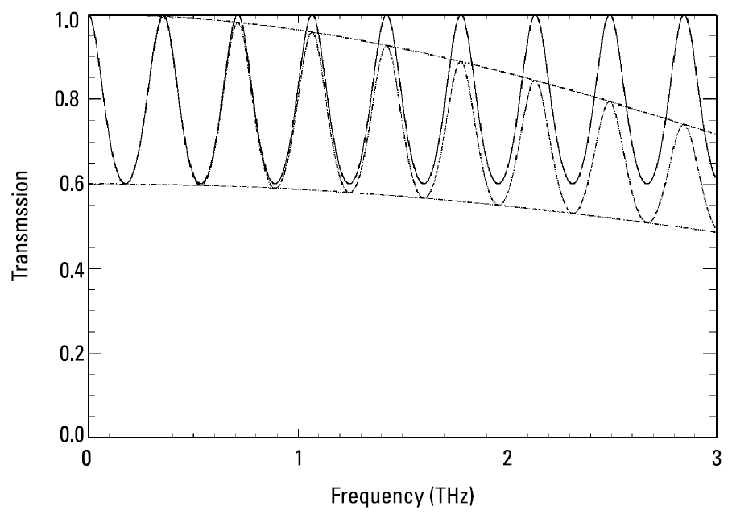
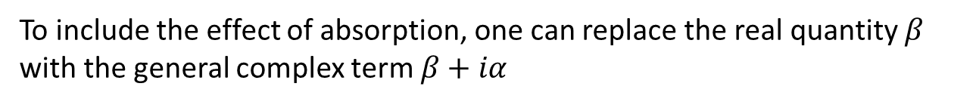
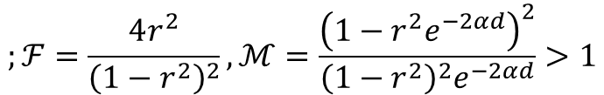



3.4 Absorption Coefficients
To include the effect of absorption, one can replace the real quantity $β$ with the general complex term $β+iα$
$$β=2πnσ, α=2πκσ$$
$$;\tilde{n}=n−iκ$$
$$T\left(σ\right)=\frac{1}{ℳ+ℱ\sin^{2}{βd}}$$
$$;ℱ=\frac{4r^{2}}{{\left(1−r^{2}\right)}^{2}},ℳ=\frac{{\left(1−r^{2}e^{−2αd}\right)}^{2}}{{\left(1−r^{2}\right)}^{2}e^{−2αd}}>1$$

Slide 21
Sources of Noise and
Uncertainties

Slide 22
4.1 Time-Domain Errors
Errors that are generically grouped and related to the correct knowledge of the position of the scanning stage
Zero Path Difference Knowledge
Encoder Errors
Timing Errors (Nonsynchronous Clocks)
Scanning Speed Nonuniformity
Generic Phase Errors
Detector Nonlinearity, Detector noise, and Detector and Source Stability
- A quadratic response
Optical element Induced
Readout Saturation
- much lower than employed: hardware adjustments
- between half and full input power: more attentions at ZPD.

Slide 23

4.2 (Software) Noise Reduction Techniques
Acquired data from an imperfect system
➔ Make the most of the available data by following technique.
Interferogram or Spectral Averaging Techniques
Signal Filtering: Pass Filter
Glitch Removal
Time Deconvolution
Nonlinearity Correction: Detector nonlinearity
Ex. Mercury Cadmium Telluride (MCT) PC antenna
$$S=\frac{K_{1}Φ }{1+K_{2}Φ}$$

Slide 24
References
Martin, D. H., and E. Puplett, “Polarised Interferometric Spectrometry for the Millimetre and Submillimetre Spectrum,” App. Opt., Vol. 10, 1969, p. 105.
Naylor, D. A., et al., “Astronomical Spectroscopy Using an Aliased Step-and-Integrate Fourier Transform Spectrometer,” Proceedings of the SPIE, Vol. 5498, 2004, pp. 685-694.
Carli, B., et al., “Design of an Efficient Broadband Far-Infrared Fourier Transform Spectrometer,” App. Opt., Vol. 38, No. 18, 1999, pp. 3945-3950.

